Slide 1
Composite Drawing for Law Enforcement
Carrie Stuart Parks
Rick Parks
Stuart Parks Forensic Associates

Slide 2
Critical Information
Introduction
Breaks
Lunch
Class hours
Homework assignments
Stuart Parks Forensic Associates
Notes:
(Hand out roster. Hand out supplies. Hand out enrollment cards. Collect enrollment cards. Start with senior students. Introduce yourselves last.)
Breaks are on the hour.
Lunch is 11:30-12:30, but you won’t start lecture until 1:00. Friday the class will end about 1:00, (not stop for lunch, so if they need to eat, bring something.)
Basic class will need to read all of tab two and answer the 11 questions at the end. You’ll go over these Wed. morning.
Click to advance slide

Slide 3
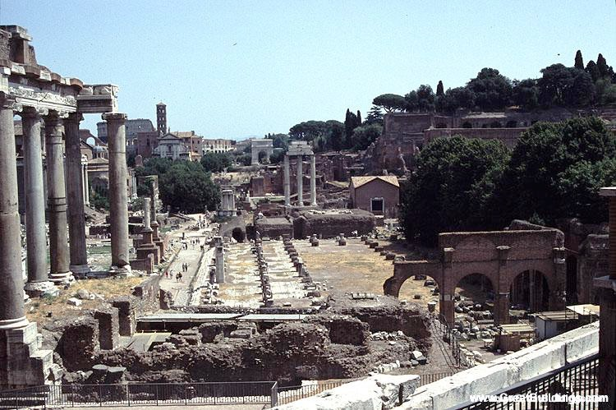
Definition: forensic
From Roman Forum
Debate
Law
“Any art that aids in the identification,
apprehension, or conviction
of criminal offenders,
or that aids in the location of victims
or identification of
unknown deceased persons.“ -IAI
Stuart Parks Forensic Associates
Notes:
The word forensic comes from the Roman forum where people would debate law, politics, and philosophies. Now the word has two meanings: debate and anything pertaining to law enforcement or legal proceedings.
Click to advance slide

Slide 4
Types of Forensic Art
Composite drawings
Image modification, image enhancement
Courtroom drawings
Demonstrative evidence
Unknown remains
Stuart Parks Forensic Associates
Notes:
Just read slide.
Click to advance slide

Slide 5
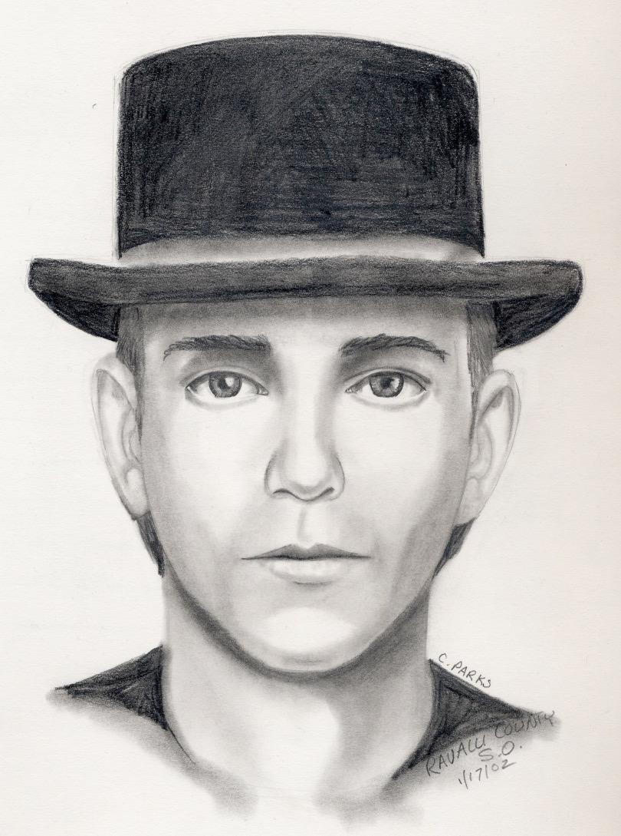
Composite Drawing
Any art made from combining different images to form a single image.
Three methods:
Freehand
Computer generated
Blend (usually with a tablet)
Stuart Parks Forensic Associates
Notes:
Read slide.
Click to advance slide

Slide 6
Composite Drawing
Aids in identification of unknown suspects
Corroborates the statements of victims or witnesses
Eliminates those not similar
May reduce paperwork
Stuart Parks Forensic Associates
Notes:
Just read slide
Click to advance slide

Slide 7
Recognition is visual ability
Recall is verbal ability
Stuart Parks Forensic Associates
Notes:
Read slide.
Recognition is the stronger memory. Composites draw upon recognition, not recall.
Click to advance slide

Slide 9
Describe the suspect

Slide 10
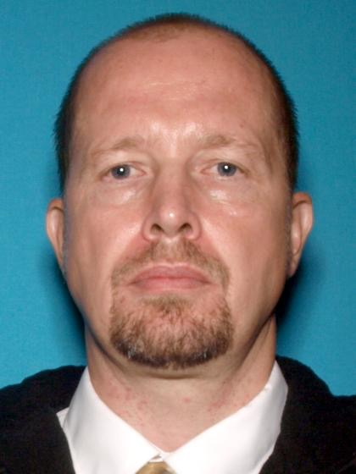
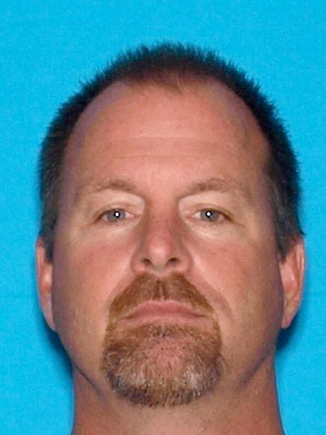
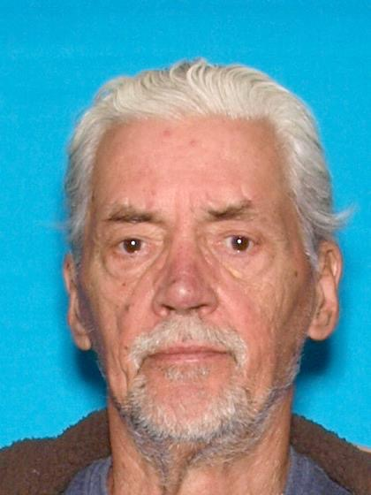
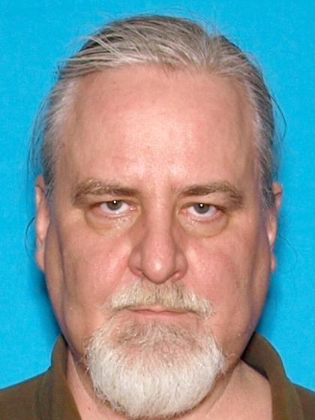
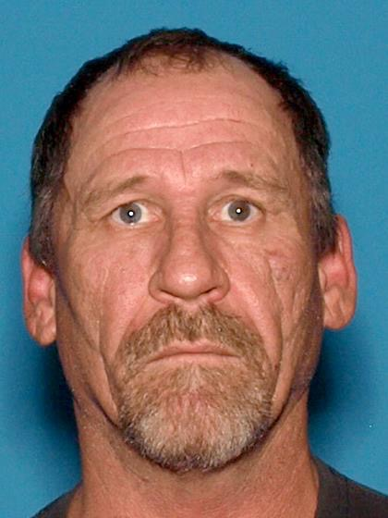
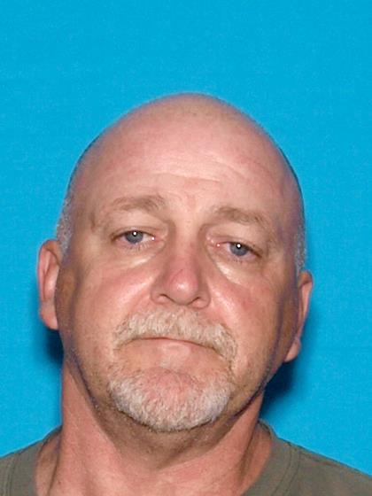
Test

Slide 11
Art VS Photograph
A photograph is real.
A photograph is of someone-though you may not know who.
You can’t have a photograph of “no one.”
Photorealism is exact art.
Notes:
Read slide.
Click to advance slide

Slide 12
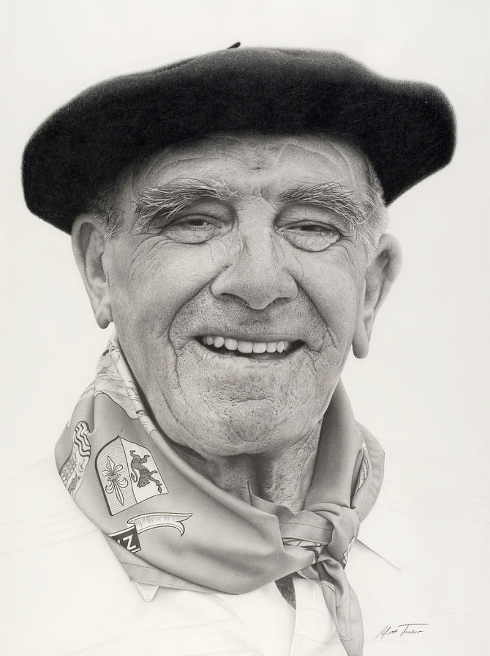
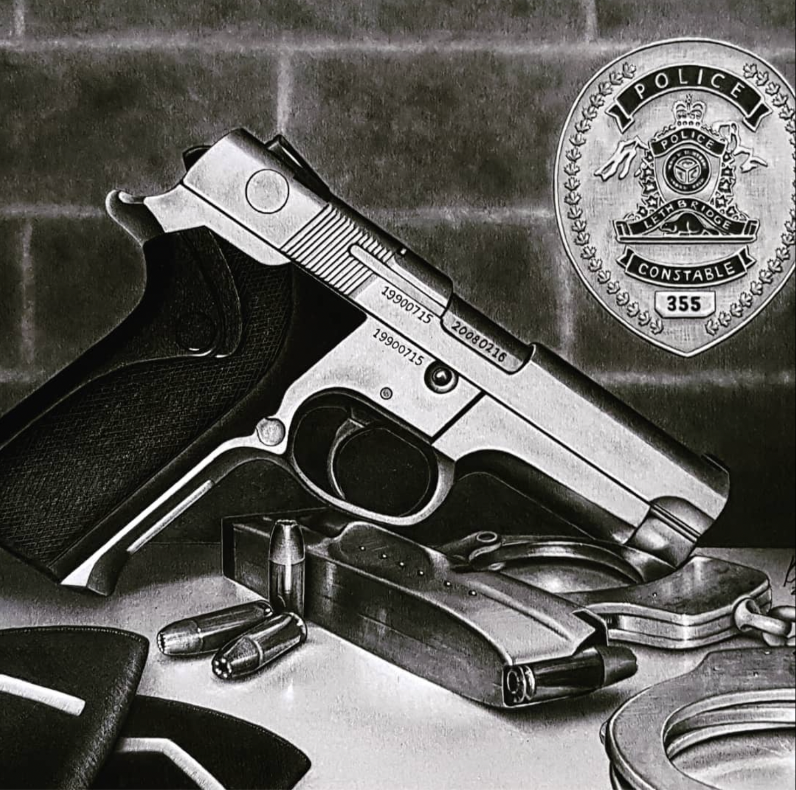
Photorealism
Notes:
Read slide.
Click to advance slide

Slide 13
Art VS Photograph
Art is like real, but not real.
Caricature identifies people through exaggeration.
Notes:
Read slide
Click to advance slide

Slide 14
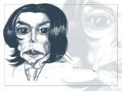
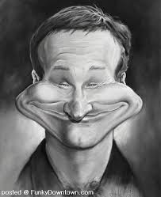
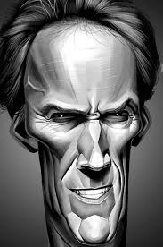
Nature of identification
Stuart Parks Forensic Associates
Notes:
Let’s talk about the nature of identification. (click to animate)
Who is this? (Michael Jackson.)
(click to animate) And this? (Bill Clinton.)
(click to animate) And this? (George Bush.)
(click to animate) And this? (the king.)
These images are not particularly close to the real face, but we can recognize them because they are in an artistic form.
Click to advance slide

Slide 15
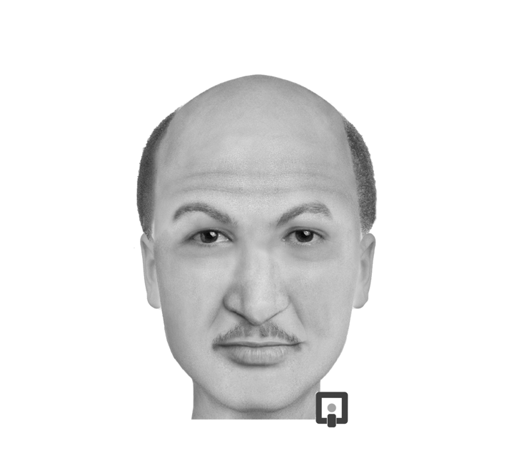
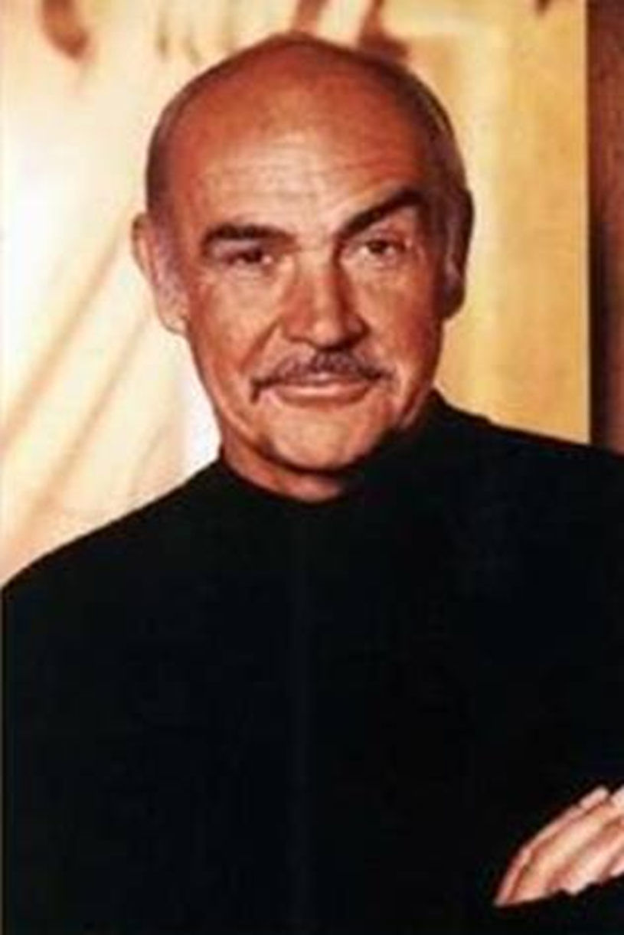
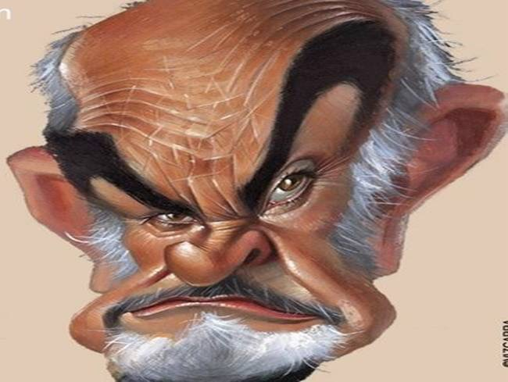
Sean Connery
Stuart Parks Forensic Associates
Notes:
Who is this? This is your competition in composites. It is the Faces system, while looking at the photograph.
Maybe it’s easier to recognize as a caricature. (click to animate.)
(Click again to animate.) (Click again to animate.)
Click to advance slide

Slide 16
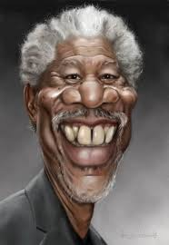
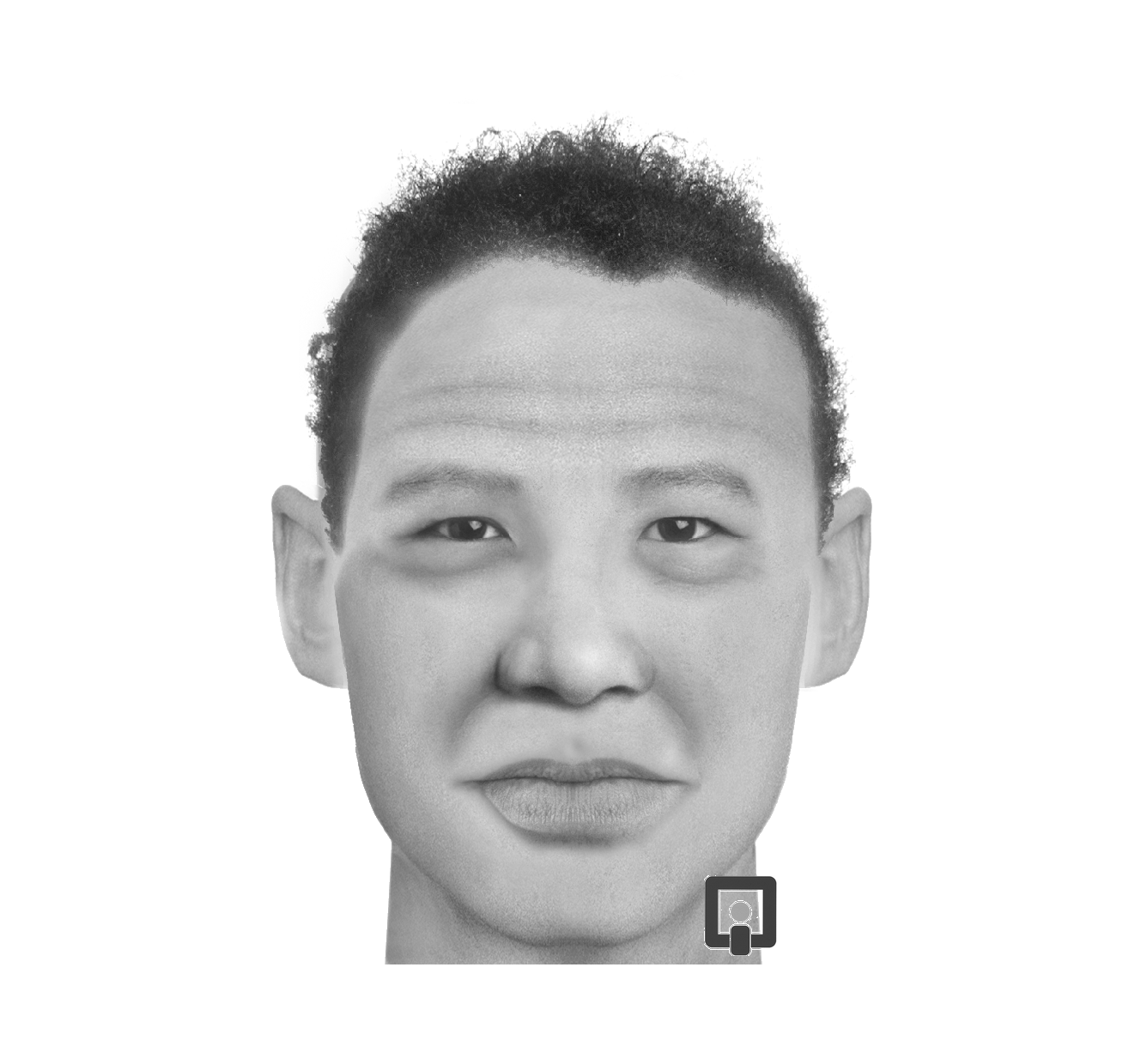
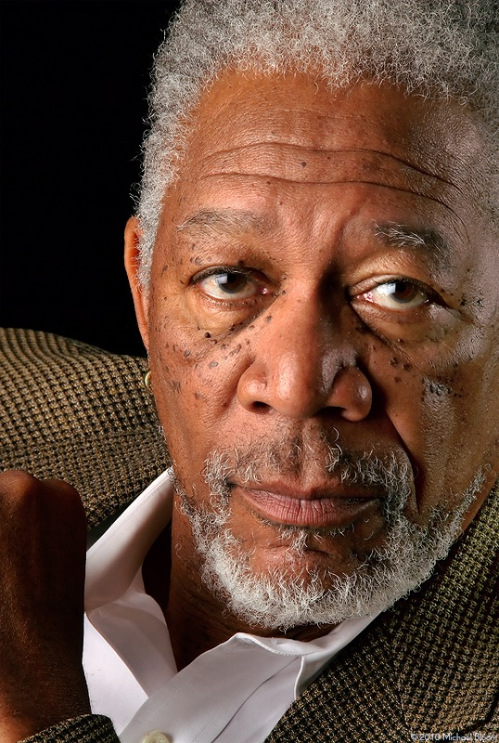
Morgan Freeman

Slide 17
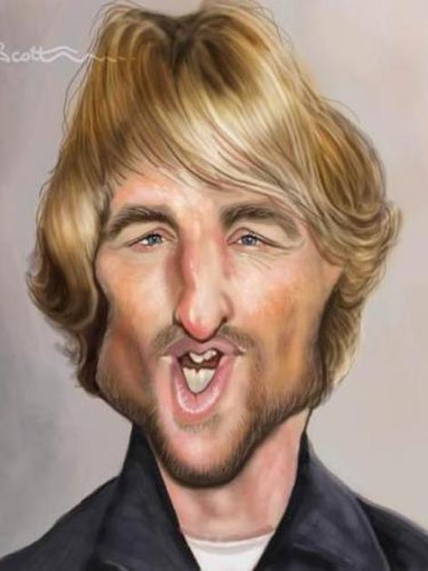
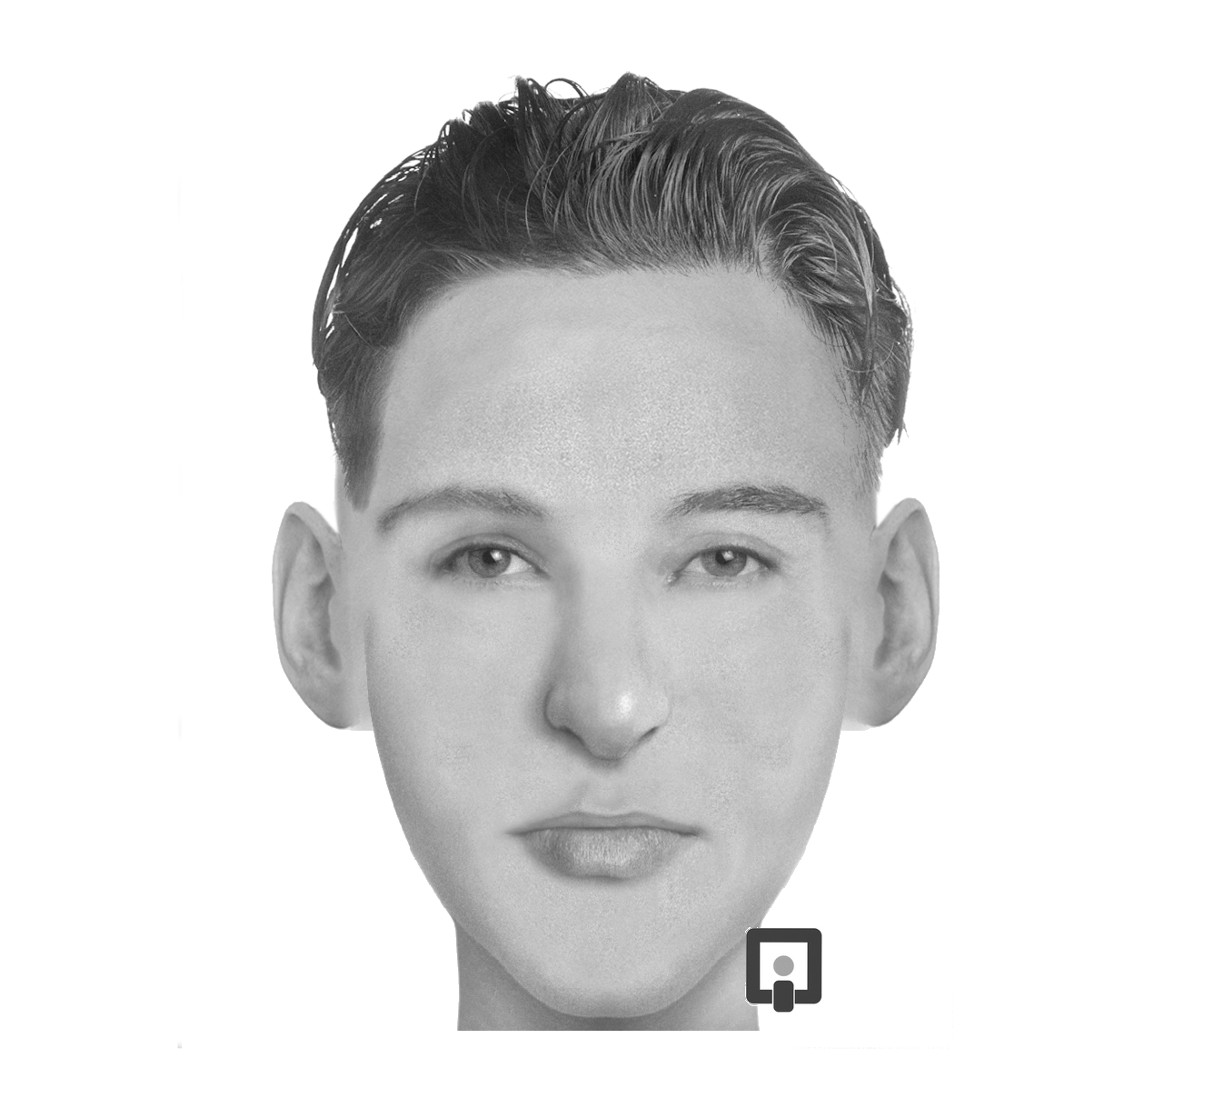
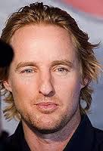
Owen Wilson
Stuart Parks Forensic Associates
Notes:
Let’s try it again.
(wait a few moments, then click to animate)
(wait a few moments, then click to animate.)
(Click again to animate.)
Click to advance slide

Slide 18
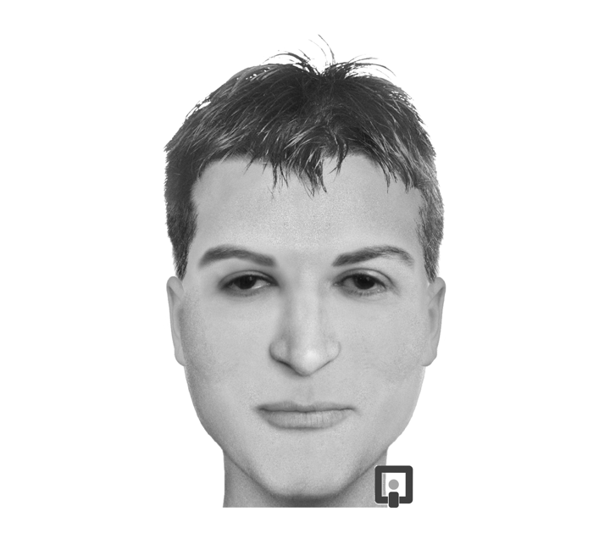
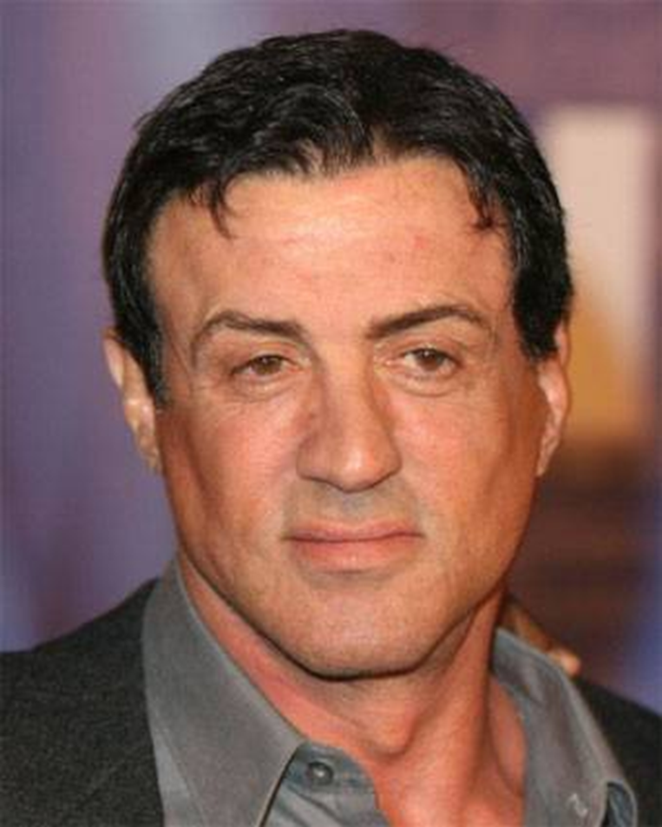
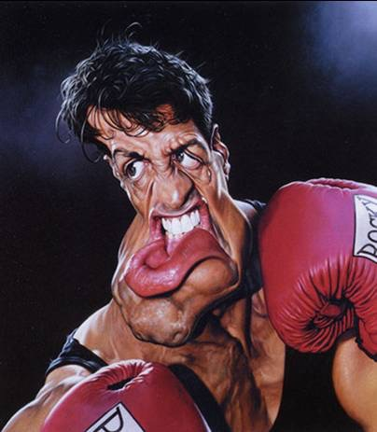
Sylvester Stallone
Stuart Parks Forensic Associates
Notes:
Let’s try it again.
(wait a few moments, then click to animate)
(wait a few moments, then click to animate.)
(Click again to animate.)
Click to advance slide

Slide 19
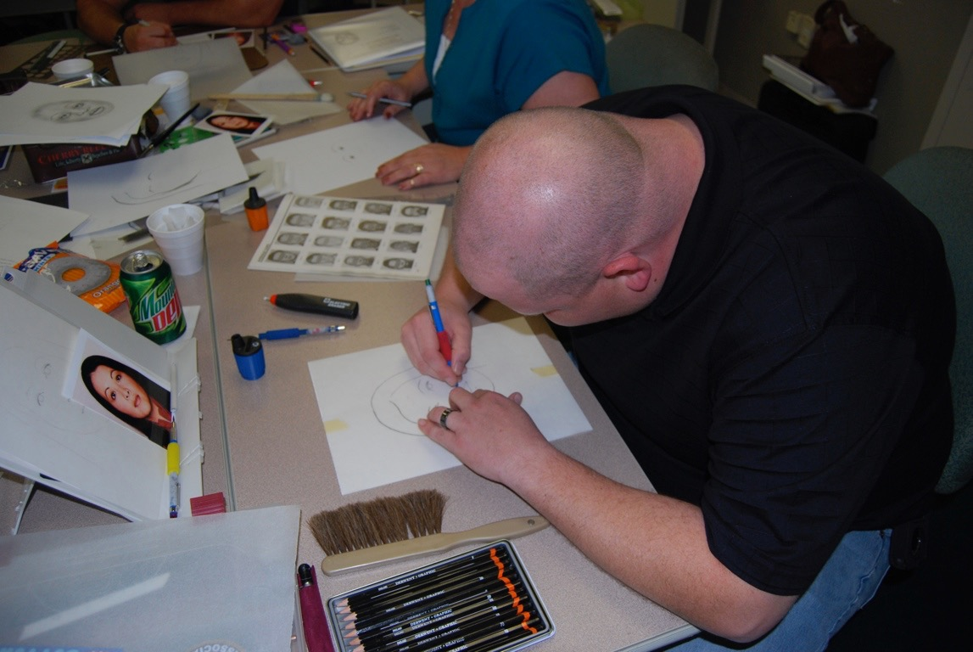
Drawing supplies
Really Cool Stuff!
Stuart Parks Forensic Associates
Notes:
click to advance slide.

Slide 20
Drawing Hot Tip
It’s not how well you draw
It’s how cool your drawing stuff is…
Notes:
Read slide.
click to advance slide.

Slide 21
Supplies: pencils
#2 Pencil
Drawing pencils
Mechanical pencils
Lead holders
Stuart Parks Forensic Associates
Notes:
(pull out supplies and demo.)
click to advance slide.

Slide 22
If you drop a pencil at the art store, don’t buy it.
Keep your pencils sharp.
Stuart Parks Forensic Associates
Notes:
Read slide.
click to advance slide.

Slide 23
Supplies: Erasers
Kneaded
White Plastic
Pink pearl
Electric
Stuart Parks Forensic Associates
Notes:
Demo.
click to advance slide.

Slide 24
Sakura is the only brand
to purchase.
Stuart Parks Forensic Associates
Notes:
click to advance slide.

Slide 25
Supplies: Paper
Drawing/sketch pad
Tracing
Bristol board
Regular
Plate/smooth
Stuart Parks Forensic Associates
Notes:
Demo
click to advance slide.

Slide 26
Supplies
Never buy the top pad.
Tear out paper from the back
of the pad.
Stuart Parks Forensic Associates
Notes:
Read slide.
click to advance slide.

Slide 27
Supplies: Drawing Surfaces
Clip board
Drawing boards
Stuart Parks Forensic Associates
Notes:
Demo
click to advance slide.

Slide 28
Supplies: Blending Tools
Paper stumps
Tortillions
Sponge
Chamois
Finger
Stuart Parks Forensic Associates
Notes:
Read off slide.
(click to animate) NEVER use your finger.
Click to advance slide

Slide 29
Supplies: Other
C-thru ruler
Circle template
Erasing shield
Tape
Brush
Stuart Parks Forensic Associates
Notes:
Demo each item.
click to advance slide.

Slide 30
Supplies: Reference Photos
FBI catalogs
Other catalogs
Mug photos
Reference magazines (glasses, hair, etc.)
Stuart Parks Forensic Associates
Notes:
Demo
click to advance slide.

Slide 31
Supplies: Nifty
Case
Glasses
Mints
Pain killers
Stuart Parks Forensic Associates
Notes:
Demo
click to advance slide.

Slide 32
Rules for the Composite Artist
No ego
It’s not a work of art
No two drawings of different suspects should look alike
Stuart Parks Forensic Associates
Notes:
Read slide.
On “no two drawings of different suspects…” say “I’m going to talk more about this in a few minutes.”
Click to advance slide.

Slide 33
Rules for the Composite Artist
The witness is always right
You’re done when the witness says so
Never argue
Listen, pay attention, write it down
Stuart Parks Forensic Associates
Notes:
Read slide.
Click to advance slide.

Slide 34
Rules for the composite artist
Call for help
carrie@stuartparks.com
rick@stuartparks.com
(208) 682-2831
Stuart Parks Forensic Associates
Notes:
Read slide
Click to advance slide.

Slide 35
Homework
Read chapter two: the interview process
Answer questions at end
Due Wednesday morning
Stuart Parks Forensic Associates
Notes:
Repeat of earlier instructions.
Click to advance slide.

Slide 36
This life’s five windows of the soul
distorts the heavens from pole to pole
and leads you to believe a lie
when you look with, not through the eye.
-William Blake
Stuart Parks Forensic Associates
Notes:
Let’s start with a poem.
(read poem)
Blake’s “five windows of the soul” are your five senses by which all incoming information reaches you. And your five senses lie to you.
We call these five senses “perception.”
Click to advance slide.

Slide 37
Perceptions
The process by which our sensory input and sensory stimulation is organized into our minds and placed into usable experience.
Stuart Parks Forensic Associates
Notes:
The definition of perception.
Some people like definitions. Sigh
Click to advance slide.

Slide 38
Perceptions
Perceptions are filters
Perceptions are powerful
Perceptions will not change
Stuart Parks Forensic Associates

Slide 39
Draw a face
Stuart Parks Forensic Associates
Notes:
Give students 15-20 minutes for this. Collect. Be sure name’s on the drawing.
Click to advance slide.

Slide 40
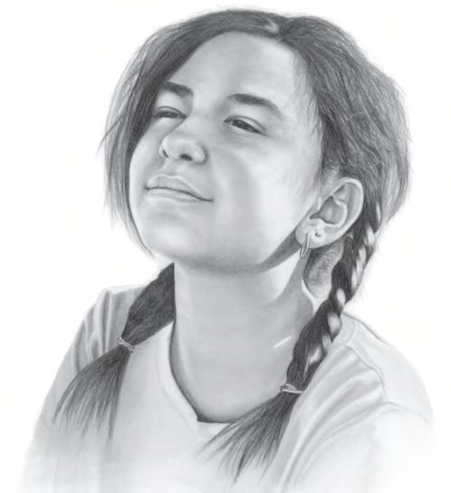
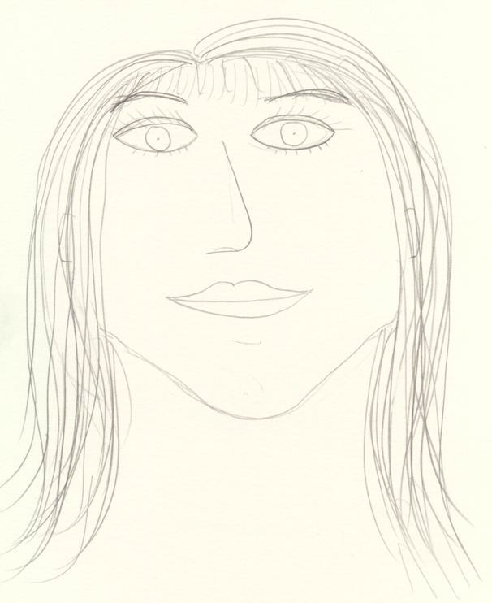
Stuart Parks Forensic Associates
Notes:
I bet your drawing looked like this.
(click to animate)
Actually most people’s drawings look like this. Why do you think this is?
It has nothing to do with talent, it has to do with how your mind processes information.
Click to advance slide.

Slide 41
Pattern Recognition
A a
A a a a a a a
Stuart Parks Forensic Associates
Notes:
Information comes into your brain and forms a “pattern of perception.” That is, your mind memorizes the pattern so you don’t have to re-learn it every time you see it.
When you went to school, you learned that the letter “a” had a shape and a sound. As you grew up, you learned the letter “a” could look a bit different (different fonts) but still meant the same thing.
Your mind has to do this so you can function, but this same memorizing of patterns causes you problems when it comes time to draw.
Click to advance slide.

Slide 42
Pattern Recognition
As we read this sentence, the hmuan mnid deosn’t raed ervey ltteer in a wrod.
The frist and lsat ltteer msut be in the crorect lcoatoin, but the rset can be ttoally mseesd up.
We raed the wrod as a whloe
Stuart Parks Forensic Associates
Notes:
Have someone read this out loud.
We stop seeing things, and our mind becomes more efficient and what it chooses to see.
Our problem is that drawing is all about seeing. Seeing things the way they are, not the way we think they should be.
Click to advance slide.

Slide 43
Pattern Recognition
The penny
Stuart Parks Forensic Associates
Notes:
If you think about a penny, it’s easy to remember that Lincoln is on one side. What else is? One Penny? One Cent? In God We Trust? Which way is Lincoln facing?
All our brain needs to know is enough information to recognize a penny, nickel, dime, quarter, and so on.
Click to advance slide.

Slide 44
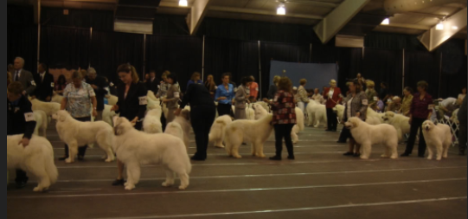
Pattern Recognition
What is your favorite hobby?
Stuart Parks Forensic Associates
Notes:
To you it might look like a dog show full of big, white, hairy dogs. To Carrie, they are different and she can tell you what bloodline they came from. Dogs are her hobby.
Talk about something YOU know—watches, banjos, etc.
Click to advance slide.

Slide 45
Where do these patterns originate?
Stuart Parks Forensic Associates
Notes:
The patterns that you use in drawing a face comes from somewhere. (click to animate)
When you drew an eye, you possibly drew something like this. Where did this shape come from? (click to animate.)
Possibly CBS?
Click to advance slide.

Slide 46
Stuart Parks Forensic Associates
Notes:
You might have drawn a nose like this.
Click to advance slide.

Slide 47
Stuart Parks Forensic Associates
Notes:
That shape came from cartoons.
Click to advance slide.

Slide 48
Stuart Parks Forensic Associates
Notes:
Or you might have made a triangle, adding my particular favorite, the pig snout option.
Click to advance slide.

Slide 49
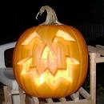
Stuart Parks Forensic Associates
Notes:
The triangle probably came from a pumpkin you carved.
Click to advance slide.

Slide 50
Stuart Parks Forensic Associates
Notes:
A mouth might look like this. (click to animate.)
Click to advance slide.

Slide 51
Stuart Parks Forensic Associates
Notes:
That’s because you want everyone to have a nice day.
Click to advance slide.

Slide 52
Stuart Parks Forensic Associates
Notes:
You might add a pair of ears and if you’re drawing straight hair, it might look like this, (click to animate) or curly hair like this.
Click to advance slide.

Slide 53
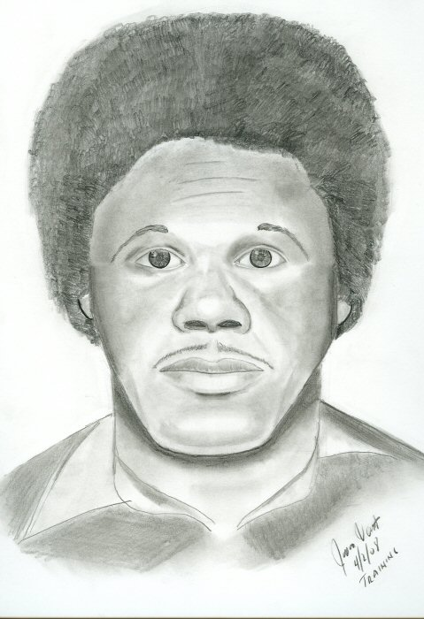
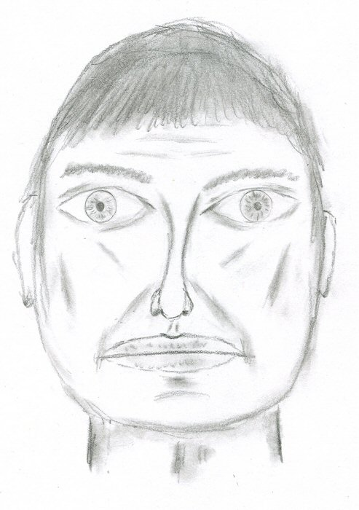
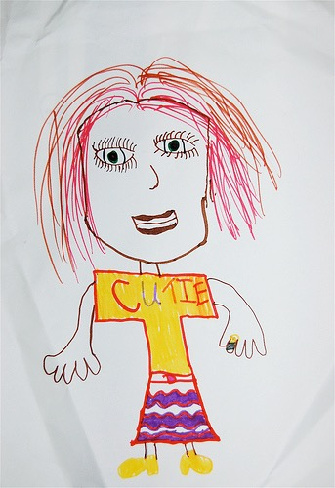
Stuart Parks Forensic Associates
Notes:
In fact, the drawings of an adult learner and that of a child are quite similar. (click to animate) But this same adult drew this sketch after one day of learning to draw.
Click to advance slide

Slide 54
Drawing Hot Tip
In order to draw anything accurately, you must be looking at it.
Stuart Parks Forensic Associates
Notes:
Read slide.
If you are not looking at a photograph, you are relying on your own imperfect and inaccurate memory to provide that information.
Click to advance slide

Slide 55
Source of information
Your witness can only provide a certain amount of information.
The rest of the composite information must come from some source
Stuart Parks Forensic Associates
Notes:
Read slide.
Your “dictionary of facial features” is limited, stylized, and incorrect.

Slide 56
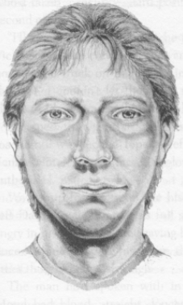
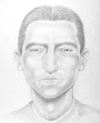
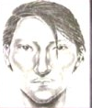
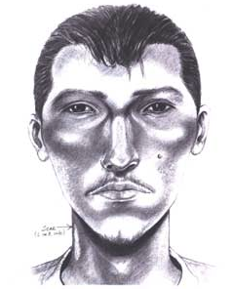
Notes:
This is a composite artist who uses her own memory to draw composites. Note:
Nose is too long
Mouth is wide, with similar shape,
Triangular head shape
Same amount of forehead
Eyes the same
Shape under mouth same
Neck same
Eyebrows same
Click to advance slide

Slide 57
So I’m looking at it...
Your mind constantly desires to place things back into a pattern.
Stuart Parks Forensic Associates
Notes:
Within five minutes you’ll stop seeing your drawing-your mind will accept whatever it is you’ve drawn.
Click to advance slide

Slide 58
Your brain lies to you
Even looking at a face doesn’t mean you accurately see that face.
Stuart Parks Forensic Associates
Notes:
Read slide.
Let’s look at examples.
Click to advance slide

Slide 59
The Problem with Grids
The average human face fits a grid
Most grids are incorrect
Stuart Parks Forensic Associates
Notes:
We will teach you a correct grid of the average face. First let’s look at the grids that are on the internet.
Click to advance slide

Slide 60
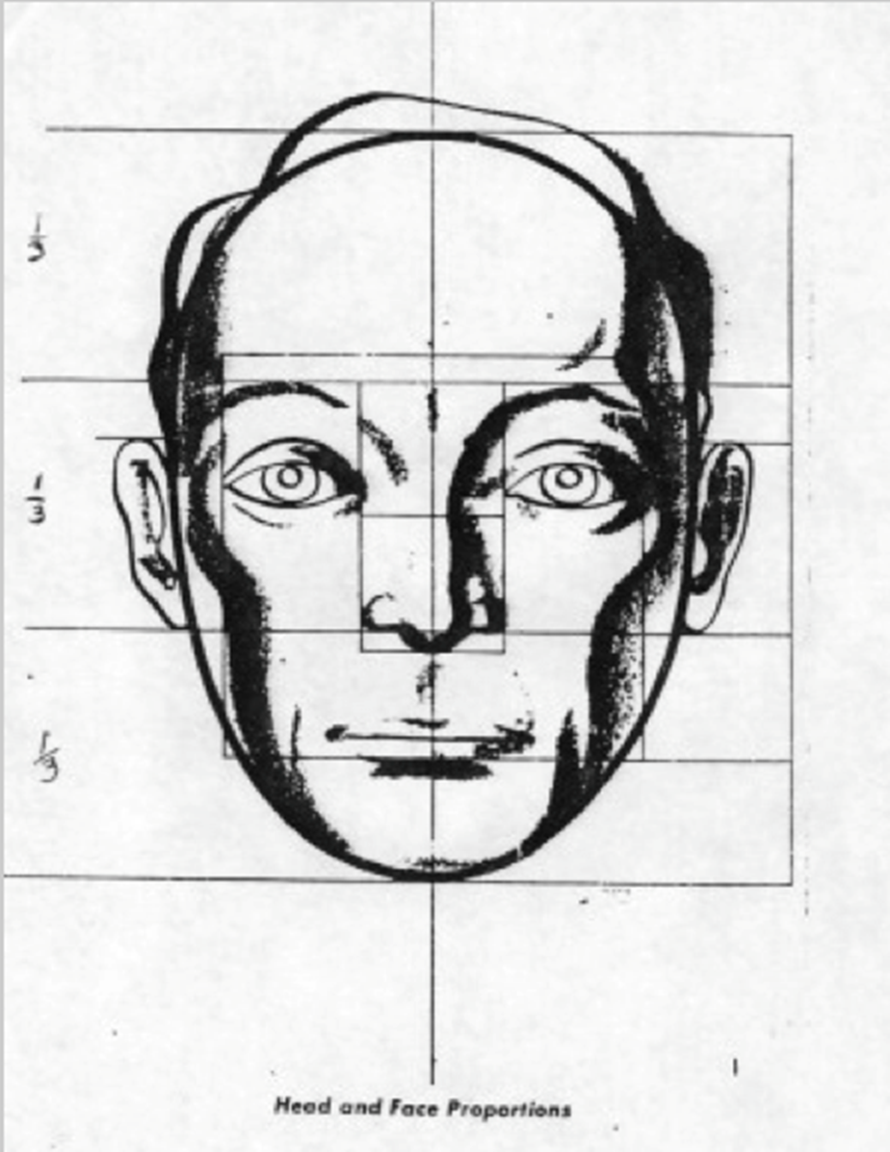
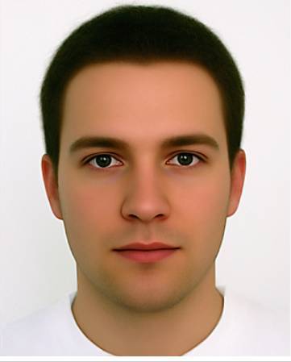
Average Male Face
Stuart Parks Forensic Associates
Notes:
This is a face created from blending thousands of average Caucasian faces. We will overlay this face with various “average face grids.”
(click to animate. Click again to return to average face.)
Click to advance slide.

Slide 61
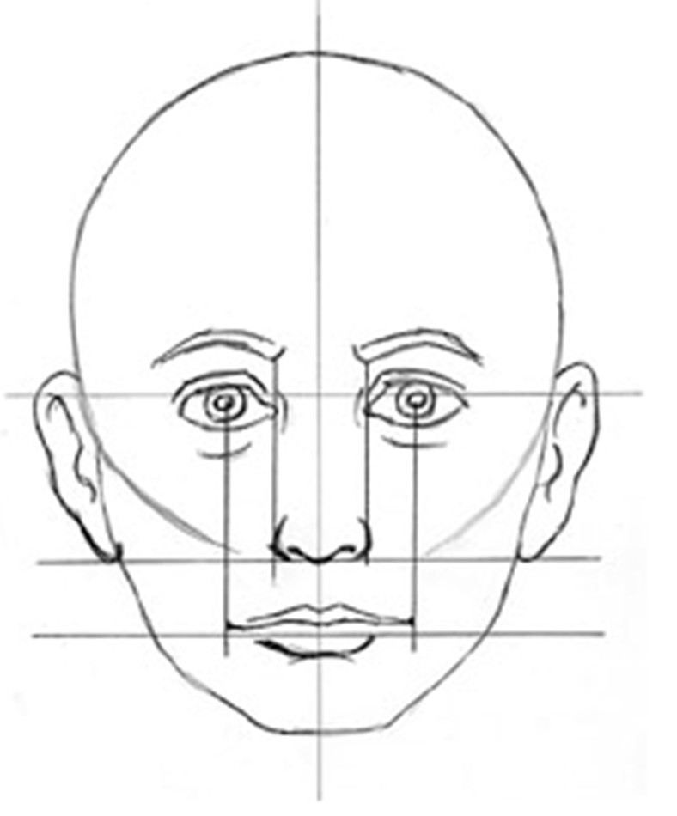
Stuart Parks Forensic Associates
Notes:
(click to animate. Click again to return to average face.)
Click to advance slide.

Slide 62
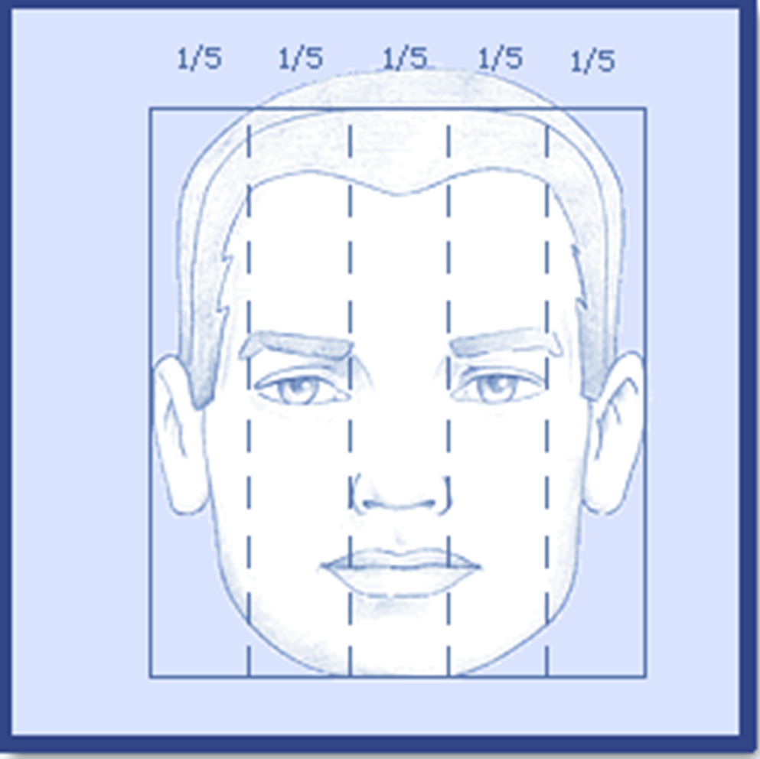
Stuart Parks Forensic Associates
Notes:
(click to animate. Click again to return to average face.)
Click to advance slide.

Slide 63
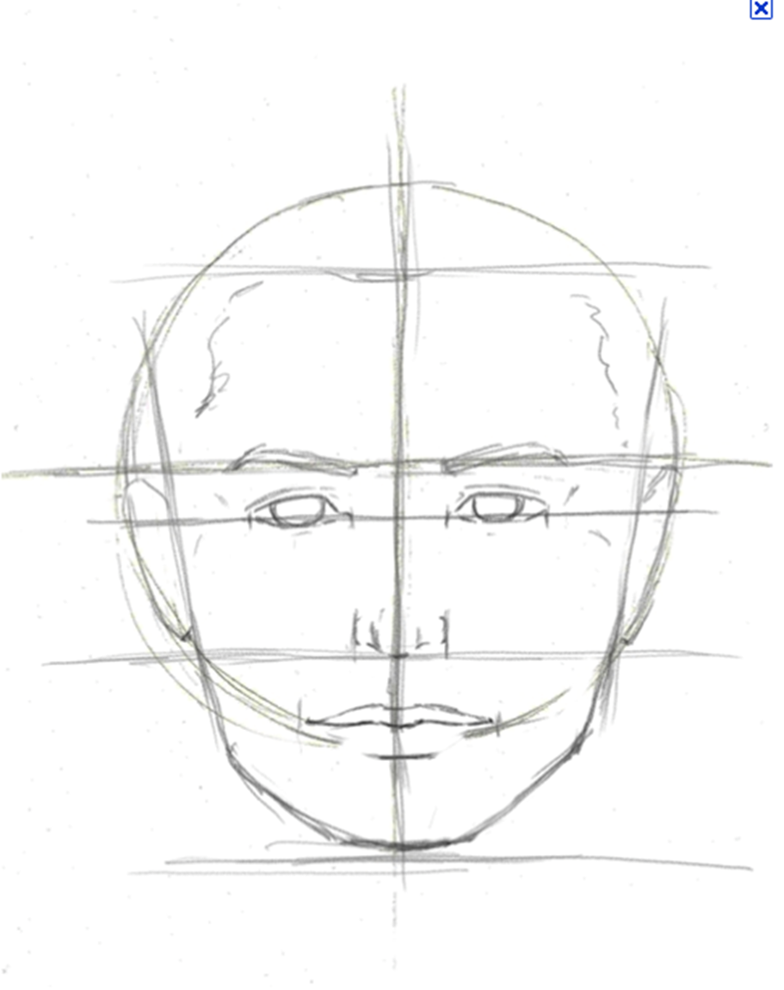
Stuart Parks Forensic Associates
Notes:
(click to animate. Click again to return to average face.)
Click to advance slide.

Slide 64
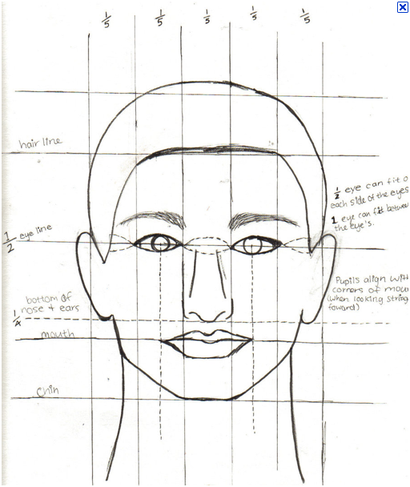
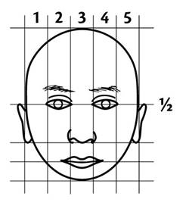
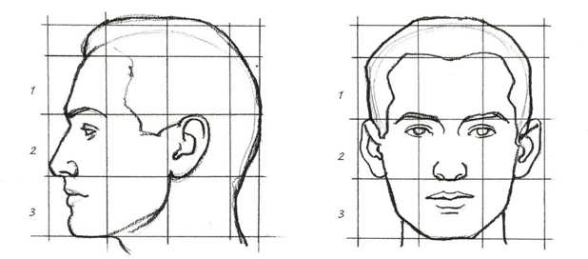
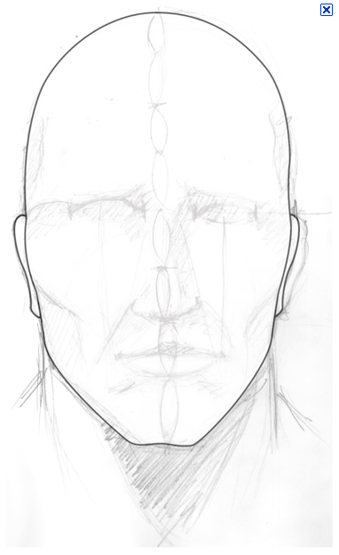
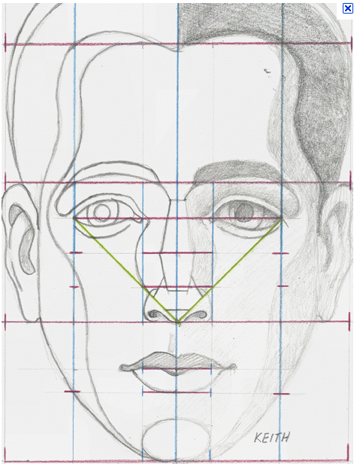
Stuart Parks Forensic Associates
Notes:
Just let this one run. It will advance itself.
Click to advance slide.

Slide 65
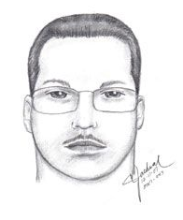
Wrong proportions= wrong composite
Stuart Parks Forensic Associates
Notes:
If you start with an incorrect proportion of a face, (click to animate) no matter how good your witness is, your drawing will be incorrect and it will be YOUR FAULT.
Click to advance slide.

Slide 66
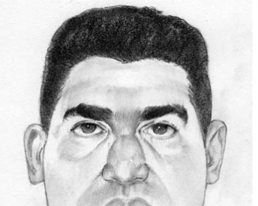
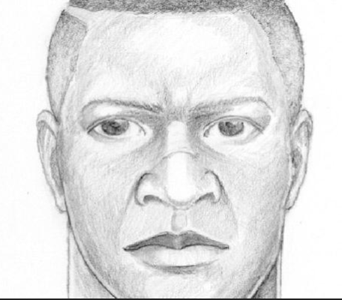
Problem Areas: Eyes
Stuart Parks Forensic Associates
Notes:
One big problem area are the eyes. (click to animate) Incorrect size of the eye, or of the iris, often combined with incorrect shape makes your drawing amaturish.
Click to advance slide.

Slide 67
Problem areas: nose
Stuart Parks Forensic Associates
Notes:
Another problem area is the nose. Most people make the nose too long. This incorrect proportion was so persuasive that Carrie did a study on it.
Click to advance slide.

Slide 68
Children’s drawings
Stuart Parks Forensic Associates
Notes:
Carrie noticed that in the drawings of children, the nose is only drawn as far up as the eyes. (go over and point to this on the screen.) Your nose, however, starts in your forehead. This would indicate that the mind doesn’t register the space between the top of the eye and the forehead. It’s invisible in our brains. So, because this is an invisible measurement, artists add this much length to the bottom of the nose.
Click to advance slide.

Slide 69
z
Stuart Parks Forensic Associates
Notes:
Here’s an average face. (click to animate.) This is the invisible part of the face. (click to animate.) Here is a typical composite with too long a nose. When we line up the eyes (click to animate) and run a line at the base of the nose (click to animate) we can clearly see the nose is too long. (click to animate.) Here is the missing part of the face, now added to the bottom of the nose.
(click to animate) A second example.
(click to animate) A third example.
Click to advance slide.

Slide 70
Notes:
The resulting problem with too long a nose is in the facial proportions. If we draw a line (click to animate) at the eyes, a line at the top of the head (click to animate) and a line at the chin (click to animate) we find the face divides into two equal parts.
From the eyes to the top of the head (click to animate) it’s the same as from (click to animate) the eyes to the chin. (click to animate).
(click to animate) An overly long nose makes the lower face too long.
Click to advance slide.

Slide 71
Wings
Notes:
The height of the wings of the nose are also a problem. (point to the wings and identify them.)
From the bottom of the nose (click to animate) to the bottom of the eye (click to animate) on most people, the wings will be between these two points (click to animate.)
Click to advance slide.

Slide 72
Notes:
(click to animate.) Most artists make the wings too short.
(click to animate.) (click to animate.) (click to animate.) (click to animate.) (click to animate.)
(click to advance.)

Slide 73
Solutions
Site
Shape
Shade
Accuracy
Stuart Parks Forensic Associates
Notes:
The solution is drawing the face using the tools of site, shape, shade, and accuracy.
(click to advance.)

Slide 74
Site
Measure
Optical index
Flatten
Stuart Parks Forensic Associates

Slide 75
Site
Also called proportion
A relationship between different elements in a work of art
Stuart Parks Forensic Associates

Slide 76
Site
Measure
If you can see it, you can measure it.
Stuart Parks Forensic Associates

